Slide 1
The Sign Effect in Consumer Intertemporal Choice: Evidence and Explanation
David Hardisty, University of British Columbia
Elke Weber, Princeton University
ACR 2019, Atlanta
Notes:
Images from unsplash.com

Slide 2
The “sign” effect (+/-)
Receive $70 now or $70 in a month?
100% choose now
Pay $70 now or $70 in a month?
47% choose later
Research questions:
Does it matter in consumer choice?
Why does it happen?
Loss aversion vs anticipation asymmetry

Slide 3
Loss Aversion?
Loss aversion (Tversky & Kahneman 1991):
losses weigh twice as much as gains
(See also : Baumeister et al 2001; Rozin & Royzman 2001)
Magnitude effect (Thaler 1981):
lower discount rates for larger outcomes
Sign effect = loss aversion + magnitude effect?
(Loewenstein & Prelec, 1992; Baucells & Bellezza 2017)

Slide 4
Not Loss Aversion
Real choices (unpublished data):
Receive $70 now or $70 in a month?
100% choose now
Pay $70 now or $70 in a month?
47% choose later
Receive $140 now or $140 in a month?
100% choose now
Pay $35 now or $35 in a month?
50% choose later

Slide 5
Anticipation?

Slide 6
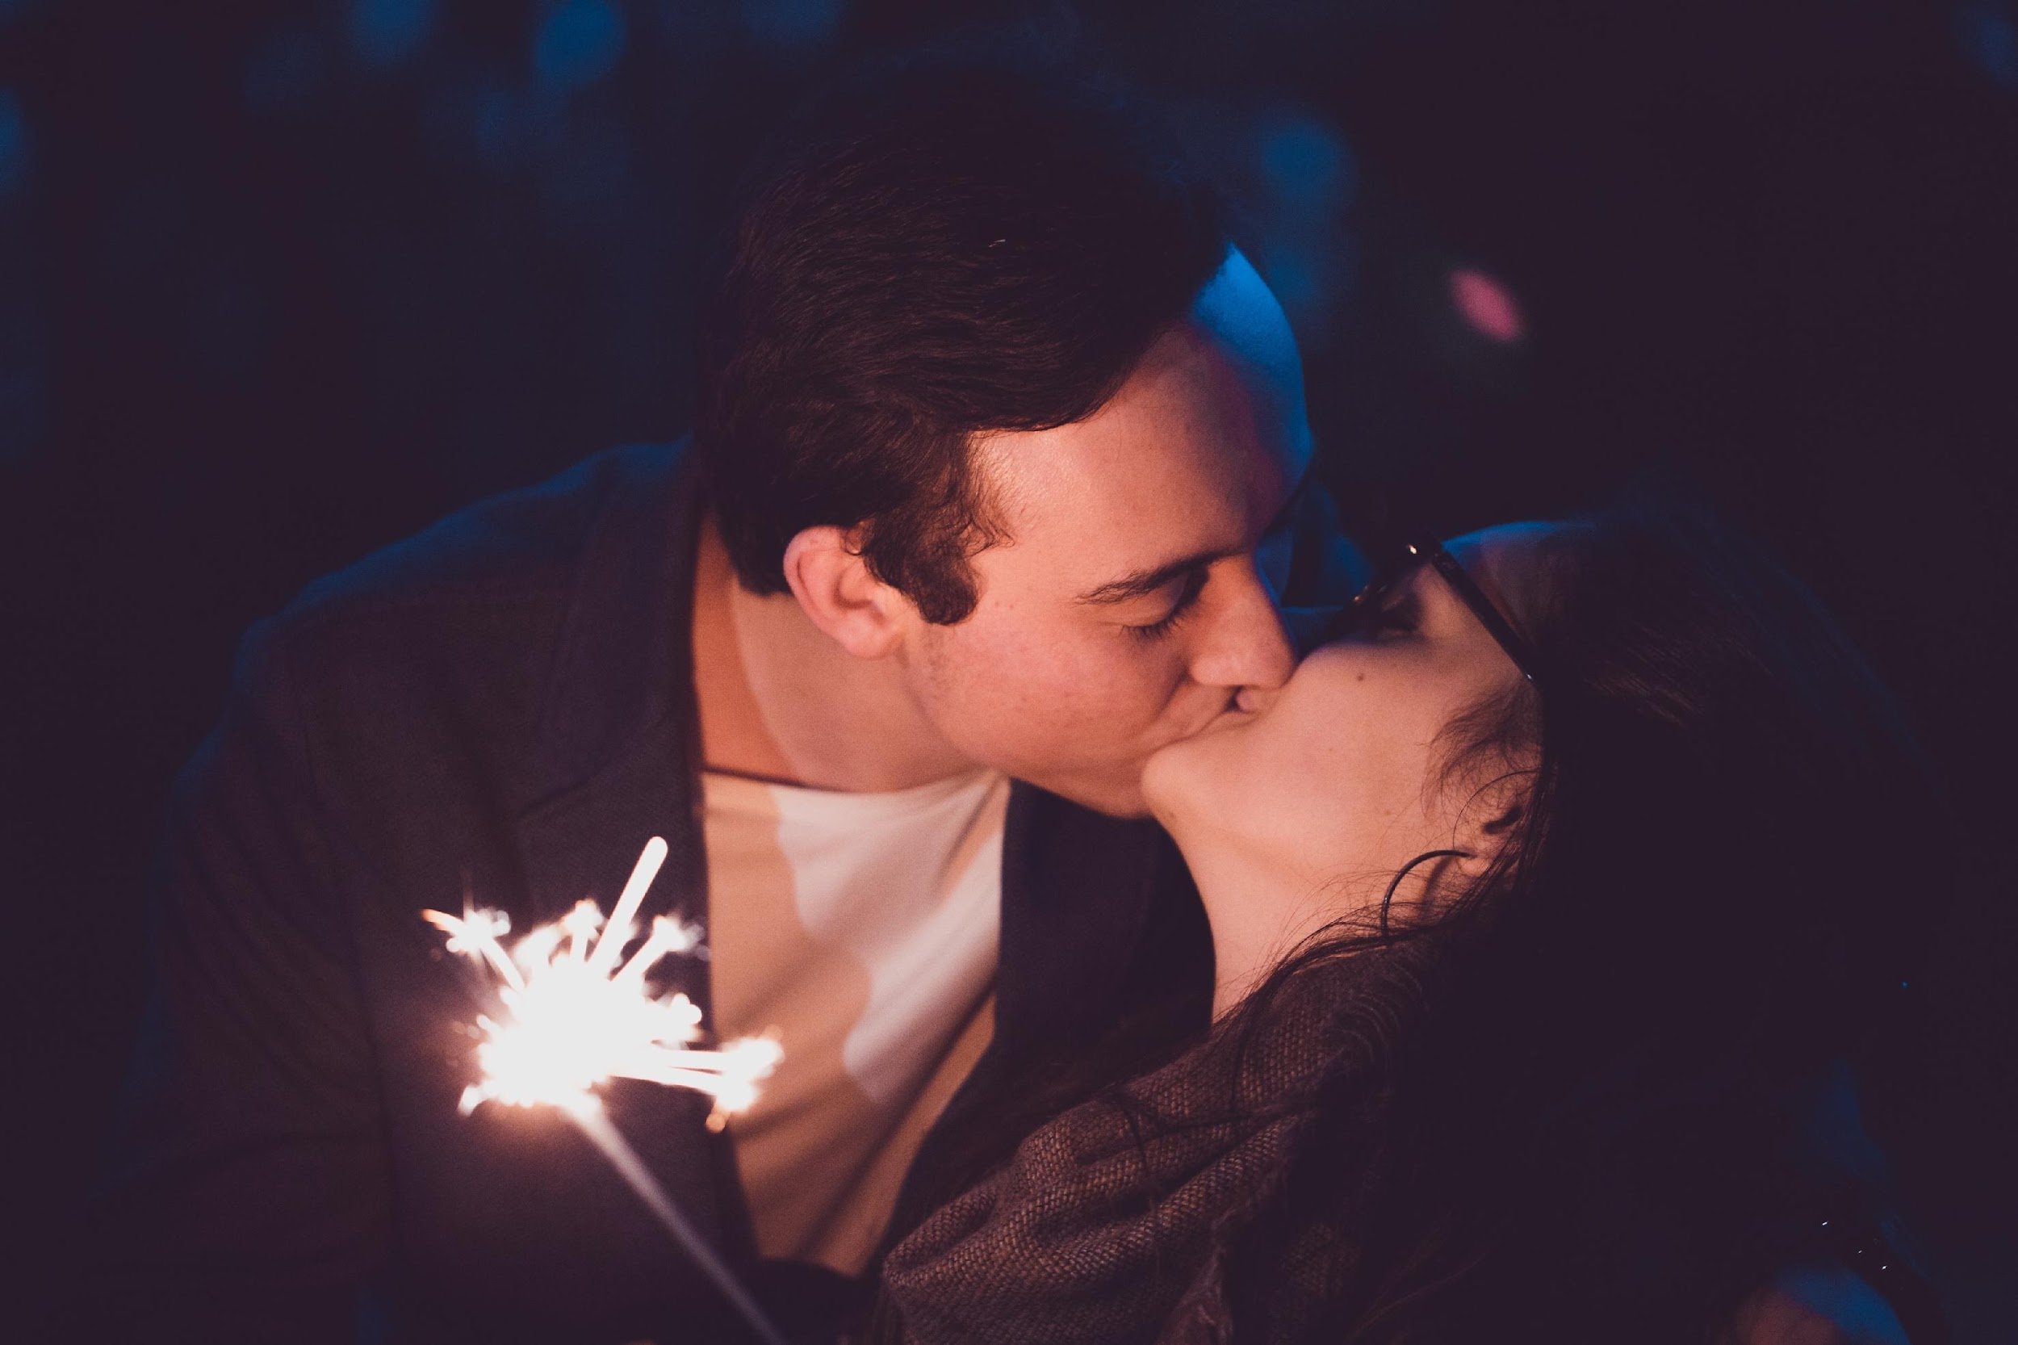
Kiss from a movie star: now or next week?
(Loewenstein, 1987)
Discounting
Anticipation
Notes:
Image from unsplash.com

Slide 7

Dental procedure: now or next week?
Discounting
Anticipation
Notes:
Image from unsplash.com

Slide 8
Anticipation Asymmetry?
Perhaps “dread” is stronger than “savoring”
Some evidence for “dread”
(Berns et al 2006; Harris 2012)
Not much evidence for “savoring”
This asymmetry may drive the sign effect

Slide 9
Why asymmetric?
Anticipation of gains is mixed
We enjoy anticipating future gains
We simultaneously dislike anticipating future gains
Anticipation of losses is unipolar
We often dislike anticipating future losses
BUT: We rarely enjoy anticipating future losses

Slide 10
Hypotheses
Replicate the “sign effect” in diverse consumer behavior contexts
Anticipation of losses > anticipation of gains
Even when controlling for loss aversion
Anticipation predicts choices
This (partly) explains the “sign effect”

Slide 11
Overview
Study 1: Delayed payments vs rebates (Hyp)
Study 2a & 2b: Retirement ad clicks (Real)
Study 3: Jellybean consumption (Real)
Study 4: Photo viewing (Real)
Notes:
It took a little while to develop these paradigms – I hope they are useful to other researchers

Slide 12
Study 1: Delayed Payments vs Rebates

Slide 13
Study 1: Anticipating payment plans vs rebates
N=200 Mturkers
2 (sign: positive vs negative) x 2 (magnitude: small vs large) between-subjects design
Scenario:
“Imagine that you are buying a new pair of glasses. Two different pricing plans are available.”

Slide 14
Positive condition:
Plan A costs $122. Plan B includes a rebate. It costs $142 now, but you would receive a $30 rebate in the mail after one month. Which would you choose?
Plan A: pay $122 now
Plan B: pay $142 now, and receive $30 in one month
Negative condition:
Plan A includes a payment plan. It costs $122 now, and you would pay an additional bill of $30 after one month. Plan B costs $142. Which would you choose?
Plan A: pay $122 now, and pay $30 in one month
Plan B: pay $142 now

Slide 15
Positive condition:
Plan A costs $61. Plan B includes a rebate. It costs $71 now, but you would receive a $15 rebate in the mail after one month. Which would you choose?
Plan A: pay $61 now
Plan B: pay $71 now, and receive $15 in one month
Negative condition:
Plan A includes a payment plan. It costs $61 now, and you would pay an additional bill of $15 after one month. Plan B costs $71. Which would you choose?
Plan A: pay $61 now, and pay $15 in one month
Plan B: pay $71 now

Slide 16
Study 1: Proportion choosing “impatient” Brand A
 | Rebate | Bill
$15 | 42% | 8%
$30 | 56% | 10%
sign, b=2.11, SE=0.59, Wald χ²(1)=12.69, p<.001
magnitude, b=0.25, SE=0.70, Wald χ²(1)=0.12, p=.73
interaction, b=0.31, SE=0.81, Wald χ²(1)=0.14, p=.71

Slide 17
Study 1: Experience Utility
Imagine receiving a check for $30 [paying a bill of $30] in one month. Would experiencing this event be pleasurable or displeasurable?
(1=pleasurable, 2=displeasurable)
Imagine receiving a check for $30 [paying a bill of $30] in one month. How strongly would experiencing this event affect your feelings at that time?
(0=Not at all, 50=Strongly, 100=Extremely)
(McGraw et al, 2010)

Slide 18
Study 1: Anticipation Utility
Imagine expecting to receive a check for $30 [pay a bill of $30] in one month. If this event were one month away, would the anticipation be psychologically pleasurable or displeasurable? In other words, how would you feel while waiting for it?
(1=like the feeling of waiting,
-1=dislike the feeling of waiting)
Imagine expecting to receive a check for $30 [pay a bill of $30] in one month. How strongly would anticipating this event affect your feelings while waiting for the event?
(0=Not at all, 50=Strongly, 100=Extremely)

Slide 19
Study 1: Anticipation Utility
Mediation: Sign->Anticipation->Choice b=.38, SE=.14, CI₉₅ [.17, .74]

Slide 20
Study 1: Controlling for Loss Aversion
Method 1: include experience utility in the analyses, all key tests remain significant, p=.001 or lower
Method 2: compare $15 bill condition with the $30 rebate condition , all key tests remain significant, p=.002 or lower

Slide 21
Study 1: Summary
Consumers care about future payments more than future rebates
Anticipation of losses is negative, contemplation of gains near zero
Anticipation predicts choices
  Even when controlling for loss aversion
However, self-report can be unreliable
  Let’s manipulate anticipation, and measure real behavior

Slide 22
Study 2: Retirement Ad Clicks

Slide 23
Study 2: Overview
Measuring clicks on Facebook ads for a retirement calculator
Facebook offers “AB Testing”
Still some “black box” issues
Endogeneity issues
Predictions:
Retirement expenses > Retirement benefits
Especially when anticipation is highlighted

Slide 24
Study 2a: Methods
2 (sign: pos vs neg) x 2 (anticipation message: absent vs present)
Budget: $50 per ad over 5 days total.
N (“reach”) = 28,568
ages 19-64
location Canada
language English
all devices
DVs:
  click-through-rate (CTR)
  cost per click
Notes:
For facebook ads: there are some constraints of course. Also: make sure the ad score is the same in each conditions

Slide 25
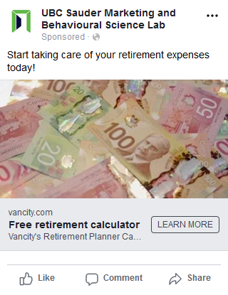
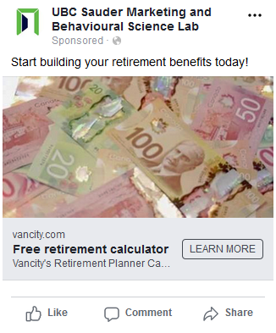
Study 2a: anticipation message absent

Slide 26
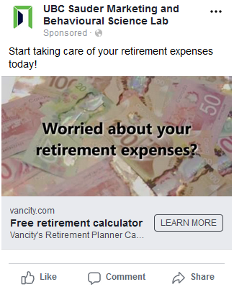
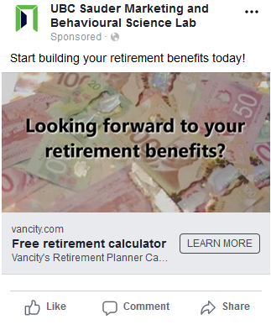
Study 2a: anticipation message present

Slide 27
Study 2a: Facebook Results (CTR)
 | Positive Frame | Negative Frame
Contemplation msg absent | 1.8% | 2.0%
Contemplation msg present | 2.6% | 3.6%

Slide 28
Study 2a: Facebook Results (CPC)
 | Positive Frame | Negative Frame
Contemplation msg absent | $0.30 | $0.31
Contemplation msg present | $0.25 | $0.18

Slide 29

Study 2b: Methods
“Cleaner” design
N (“reach”) = 90,076
Canadians ages 22-64

Slide 30

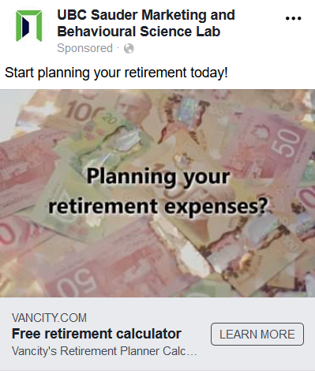
Study 2b: anticipation word absent

Slide 31

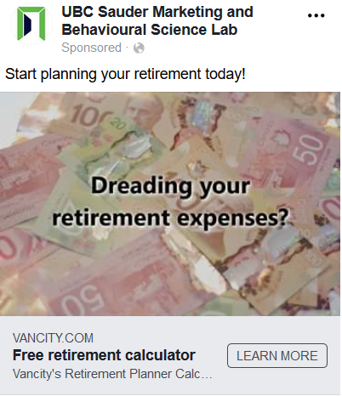
Study 2b: anticipation word present

Slide 32
Study 2b: Results
Click-Through-Rate
 | Control (“Planning”) | Anticipation (“Savoring” or “Dreading”)
Positive (“Benefits”) | 2.9% | 2.5%
Negative (“Expenses”) | 2.8% | 3.4%

Slide 33
Study 2b: Results
Cost-Per-Click
 | Control (“Planning”) | Anticipation (“Savoring” or “Dreading”)
Positive (“Benefits”) | $0.27 | $0.30
Negative (“Expenses”) | $0.28 | $0.23

Slide 34
Study 2: Summary
Anticipation of retirement expenses is more motivating than anticipation of retirement benefits
…above and beyond simple expenses vs benefits

Slide 35
Study 3: Jellybean consumption
How can we give matched positive and negative experiences in the lab?

Slide 36
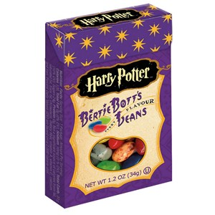
Study 3: Jellybean Flavors
Watermelon
Green Apple
Chocolate Donut with Sprinkles
Candyfloss
Tutti-Fruitti (mixed fruit)
Banana
Marshmallow
Blueberry
Lemon
Strawberry Iced Donut
Grass
Earthworm
Soap
Black Pepper
Dirt
Sausage
Earwax
Rotten Egg
Booger
Vomit

Slide 37
Study 3: Methods
Jellybeans mentioned in recruitment materials and visible in the experimental room
Each participant rated 20 jellybean flavors as positive or negative and ranked them from best to worst
Titrated to find a matched pair (one pos, one neg) for each participant
  “Would you accept a 50/50 gamble to eat a Marshmallow flavored jellybean or a Grass flavored jellybean”?
Participants were then assigned to either the positive flavor first or negative flavor first
Rated anticipation and experience utility
Chose when to eat the jellybean

Slide 38
Study 3: Choice Results
 | Good Flavor | Bad Flavor
Chose “now” | 73% | 81%
Chose “discounting” | 73% | 19%

Slide 39
Negative flavor
Positive flavor

Slide 40
Study 3: Summary
With jellybean consumption, individually matching positive vs negative intensity: same results

Slide 41
Study 4: Photo Viewing

Slide 42
Study 4: Methods
N=100 MTurkers
Assigned to view 10 photos of puppies or 10 photos of cockroaches
Time preference
  When do you want to look at the photos? Now, or at the end of the study (in 5 minutes)?
Anticipation utility (positive and negative separately)
  As you think about the photos you will see at the end of the study, how pleasurable or happy is the anticipation?
  As you think about the photos you will see at the end of the study, how displeasurable or unhappy is the anticipation?
5 min unrelated task & view the photos
(in order chosen)

Slide 43
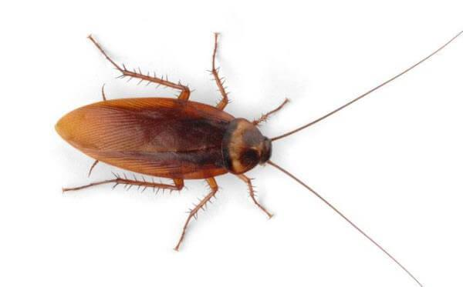

Slide 44
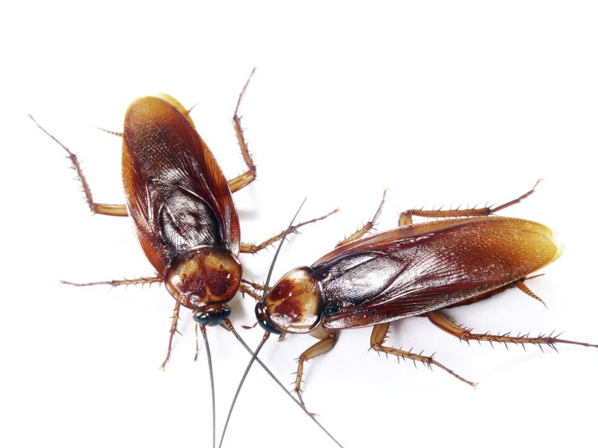

Slide 45
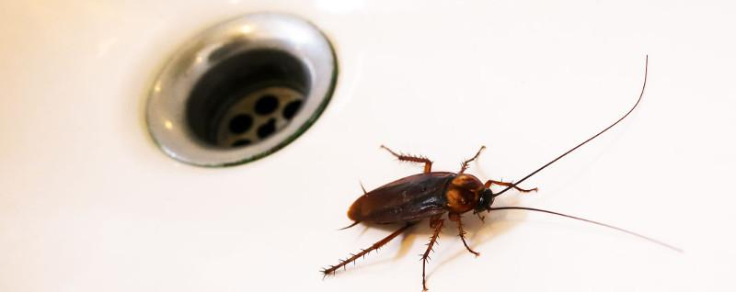

Slide 46
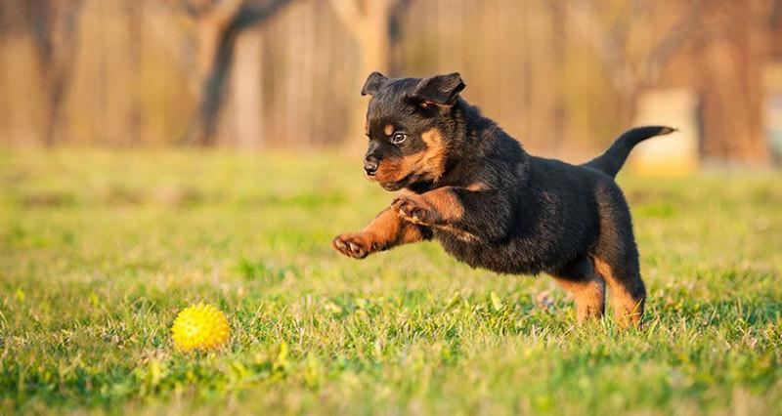

Slide 47
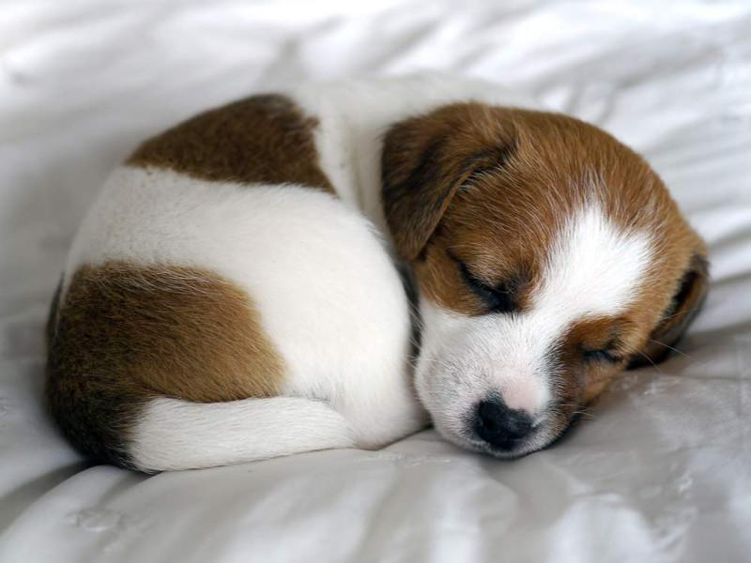

Slide 48
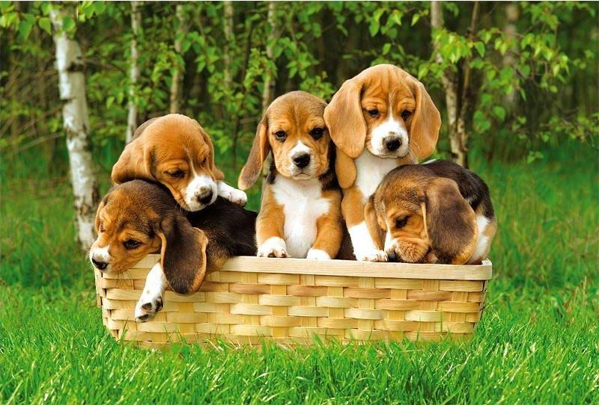

Slide 49
Study 4: Results
 | Puppies | Cockroaches
Choose now | 63% | 73%
Chose disco | 63% | 27%
Positive Anticipation | 40 | 17
Negative Anticipation | 33 | 54

Slide 50
Study 4: Summary
Puppies: people report both positive anticipation and negative anticipation
Cockroaches: people report negative anticipation but not positive anticipation

Slide 51
Summary
“Sign effect” replicated across multiple consumption contexts
Anticipation of losses > anticipation of gains
Anticipation of gains is emotionally mixed
Anticipation of losses is more unidimensional
Anticipation predicts choices
  loss aversion does not
This (partly) explains the “sign effect”

Slide 52
Thank You!

